Slide 1
Responsive Design
WEBD 152 - Web Programming 2
Link to slides: http://bit.ly/humber-web-2-3
Ryan Christiani
Week 3

Slide 2
Review
Fluid Formula: (target / context) * 100 = result
@media type vs feature
max-width vs min-width

Slide 3
Fixed VS Fluid Layouts cont.
Most of the page components in a fluid page layout adjust to the user's screen size by using percentage widths rather than fixed pixel widths. Fluid layouts are also sometimes referred to as a liquid layout. To calculate pixels to percentages, use this formula:
(target / context) * 100 = result
EX: (700px / 1000px) * 100 = 70% (This is the section)
Lets apply this to our design. Note we will give the wrapper a max-width, more on that later.

Slide 4
PERCENTAGES, DECIMALS
Let's say you have 2 columns within a container that is 960px. The section is 700px and the aside is 260px.
(target / context) * 100 = result
section (700px / 960px) * 100 = 72.91666667%
aside (260px / 960px) * 100 = 27.08333333%

Slide 5
PERCENTAGES, DECIMALS cont.
How many decimals should you use? If you look at Ethan Marcotte's example, some of the width values have 18 decimal points. The CSS spec gives no guidelines, so browser are free to make their own rules.
Webkit and Opera always round down, FireFox and Internet Explorer 8 and 9 round some numbers up, others down, and IE6 & IE7 always round up.
I tend to try and have as few decimals as possible. Simply round to the nearest whole number. 72.916666667 becomes 73 and 27.08333333 becomes 27. together they make 100. For the most part this will always work, we will discuss some edge cases in the future.

Slide 6
Media Types Vs Media Queries
Media types are used to specify how a document is presented on different media: screens, printed on paper, with a braille device, etc.
On an HTML page, it is included using a media attribute in the <link> element. For example, using media="screen" loads a stylesheet for the device screen and media="print" loads a print specific stylesheet.
<link rel="stylesheet" type="text/css" href="main.css" media="screen"> <link rel="stylesheet" type="text/css" href="print.css" media="print">

Slide 7
Media Types Vs Media Queries
You can also add the media type within a stylesheet like such.
@media print {
}
There are many different recognized media types (all, braille, embossed, handheld, print, projection, screen, speech, tty, tv). If the media type is not declared, it defaults to all.

Slide 8
Media Features
Most media features can be used with min- or max- prefixes to express "greater or equal to" and "smaller or equal to". The media features that accept prefixes can be used alone but are generally more flexible when used with prefixes.

Slide 9
Media Feature - Width
Width refers to the width of the browser’s visible screen area or viewport including the size of a scroll bar (if applicable).
In the previous examples, we used the prefixes, min- and max- to set either a min-width or max-width condition. These features can also be used together to specify a range. For example, you may want to create a media query for a resolution that targets tablets, netbooks and landscape or larger phone screens and small desktops. It would need to be greater than a mobile screen but smaller than a desktop screen.

Slide 10
Syntax and Usage
A media query consists of a media type and at least one media feature, such as width or height. The media feature needs to be contained in parenthesis ().
<link rel="stylesheet" type="text/css" media="screen and (max-width: 480px)" href="mobile.css">
The above example is checking if the device's horizontal screen resolution (media type) has a max-width (media feature) that is equal to or less than 480px. If so, the device will load mobile.css. Otherwise, the link is ignored.

Slide 11
Syntax and Usage
Just like media types, media queries can also be included as CSS using @media.
@media screen and (max-width: 480px) { /* all targeted styles are nested inside the media query declaration block */ .wrapper { ... } }

Slide 12
Exercise
You are provided with a very simple design, take some time and convert it to be a responsive design.
Don’t over think it.
Lets take 30 mins to complete this, and then we will walk through it together.
Files Here

Slide 13
Device Width
Although iPhones and Android phones are popular mobile products, it's best practice to avoid targeting specific devices. Instead, we can target device sizes.
EX: ipad width is 768, the iphone is 320.
Even targeting specific device sizes can be an issue when you look at the number of devices sizes actually out there, we will discuss working on that later.

Slide 14
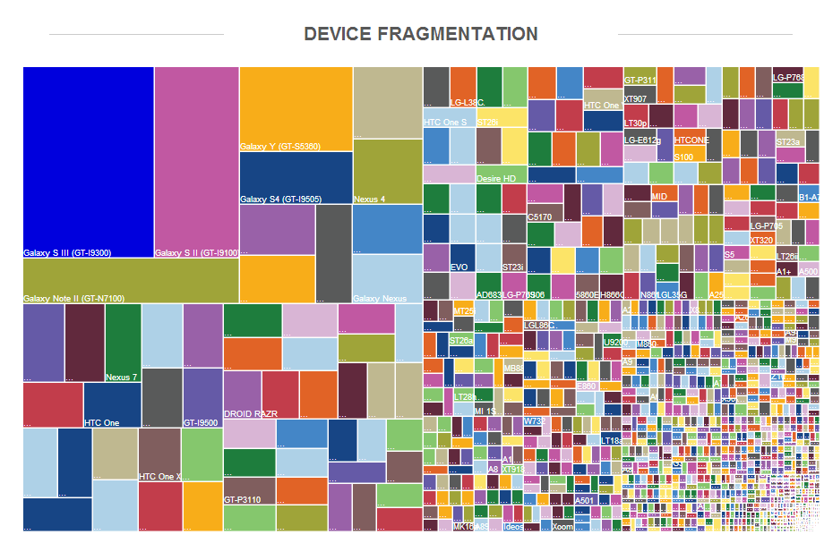

Slide 15
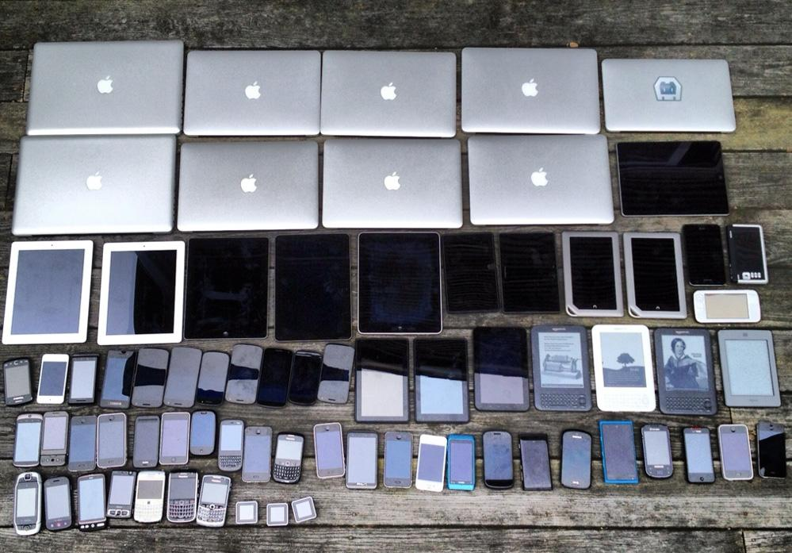

Slide 16
Device Width cont.
device-width refers to the width of the device's screen, not the browser window. For example, if your screen's resolution is 1280 x 1024, the width is 1280 pixels wide, with a device-width of 1280px.
So then what is the difference? device-width only applies to mobile devices, not desktop or laptop computers. Usually, width is sufficient for creating responsive webpages.
On desktops, if the user resizes the browser, the width changes. On mobile browsers, the window will stay constant since the browser cannot be resized.

Slide 17
The Viewport.
In order for all of this to work we need to understand the viewport. The simple explanation is that the viewport is the part of the page that is visible. The default with will be the width of the device is pixels.
To set the viewport we use a meta tag in the head.
<meta name="viewport" content="width=device-width">
This is necessary for allowing a site to respond on a mobile device.

Slide 18
Retina
With the introduction of High Density Pixels (HiDPI) or Retina display (branded by Apple), these pixels no longer correspond to the device size. Two device pixels are crammed into each CSS pixel on the screen, making the content on the screen clearer and crisper. For example, the iPhone 4 resolution is 640 x 960 but still has a device-width of 320px.
This doesn't affect how we write our CSS but it does affect how images are rendered. Images and graphics will be stretched by 2x it's original size and results in fuzzy images.

Slide 19
Device Pixel Ratio
The device-pixel-ratio media queries can be used to swap in images that are 2x as big for HiDPI/Retina devices to avoid fuzzy images. This will be discussed in more detail in another lesson.
@media screen and (device-pixel-ratio: 2) { … }

Slide 20
Other Media Features
For the majority of your media queries, width is sufficient and sometimes height. There are however many more features that can be used.
aspect-ratio
device-aspect-ratio
color
color-index
monochrome
resolution
scan
grid

Slide 21
Common Breakpoints
320px — Mobile portrait
480px — Mobile landscape
600px — Small tablet
768px — Tablet portrait
940px - 1024px — Tablet landscape, netbook, small desktop
> 1280px — Desktop
These are just general guidelines. Depending on the design and the scope of the project, you may need to target different resolutions and add media queries at different breakpoints. A responsive design should however, have at least have 3 breakpoints to optimize for mobile phones, tablets and desktops/laptops.

Slide 22
Next Week
Cross Browser testing
Assignment #2 introduction.

